Slide 1
Odyssey Characters

Slide 2
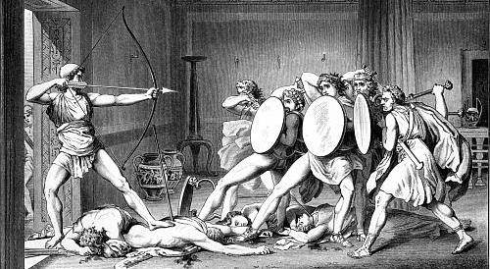
Odysseus fought among the other Greek heroes at Troy and now struggles to return to his kingdom in Ithaca. Odysseus is the husband of Queen Penelope and the father of Prince Telemachus. Though a strong and courageous warrior, he is most renowned for his cunning. He is a favorite of the goddess Athena, who often sends him divine aid, but a bitter enemy of Poseidon, who frustrates his journey at every turn.

Slide 3
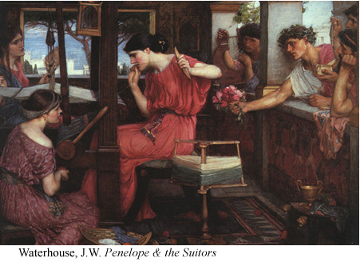
Penelope is the wife of Odysseus and mother of Telemachus. Penelope spends her days in the palace weaving and wishing for Odysseus’ return home.

Slide 4
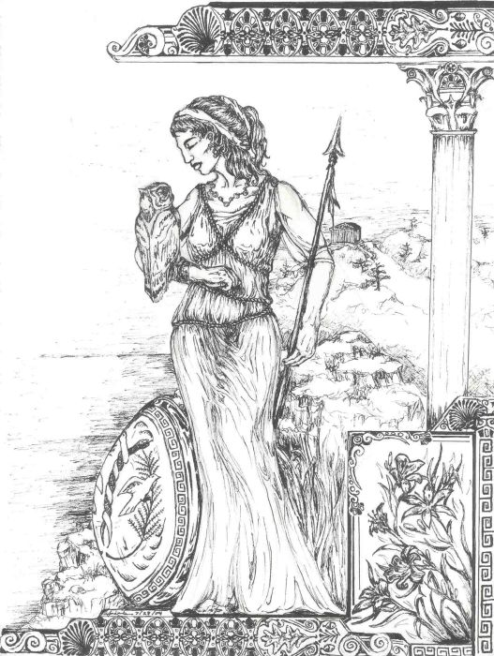
Athena is the daughter of Zeus and goddess of wisdom and war. Athena assists Odysseus and Telemachus with divine powers throughout the story, and she speaks up for them in the councils of the gods on Mount Olympus. She often appears in disguise as Mentor, an old friend of Odysseus.

Slide 5
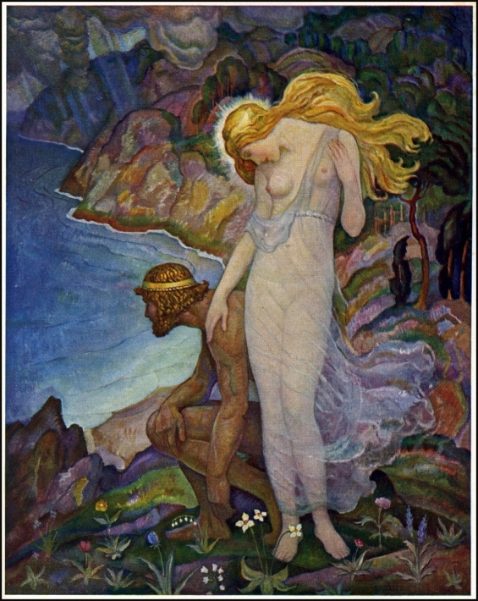
Calypso is the beautiful nymph who falls in love with Odysseus when he lands on her island-home of Ogygia. Calypso holds him prisoner there for seven years until Hermes, the messenger god, persuades her to let him go.

Slide 6
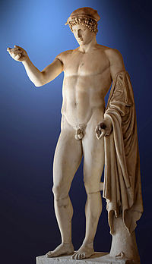
Hermes was the messenger of the gods and guide of dead souls to the Underworld. A prankster and genius, Hermes aided the heroes Odysseus and Perseus in their quests.

Slide 7
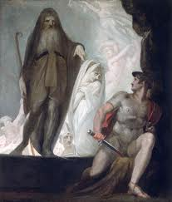
Tiresias is a blind prophet who inhabits the underworld. Tiresias meets Odysseus when Odysseus journeys to the underworld. He shows Odysseus how to get back to Ithaca and allows Odysseus to communicate with the other souls in Hades.

Slide 8
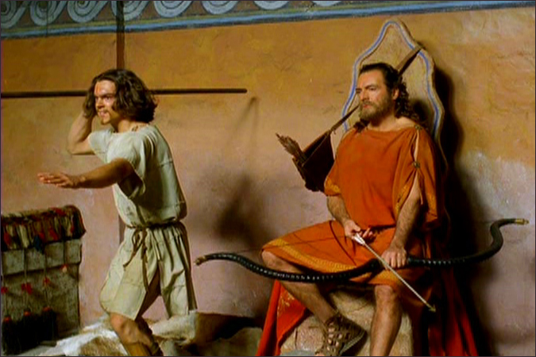
Telemachus is Odysseus’s son. An infant when Odysseus left for Troy, Telemachus is about twenty at the beginning of the story.

Slide 9
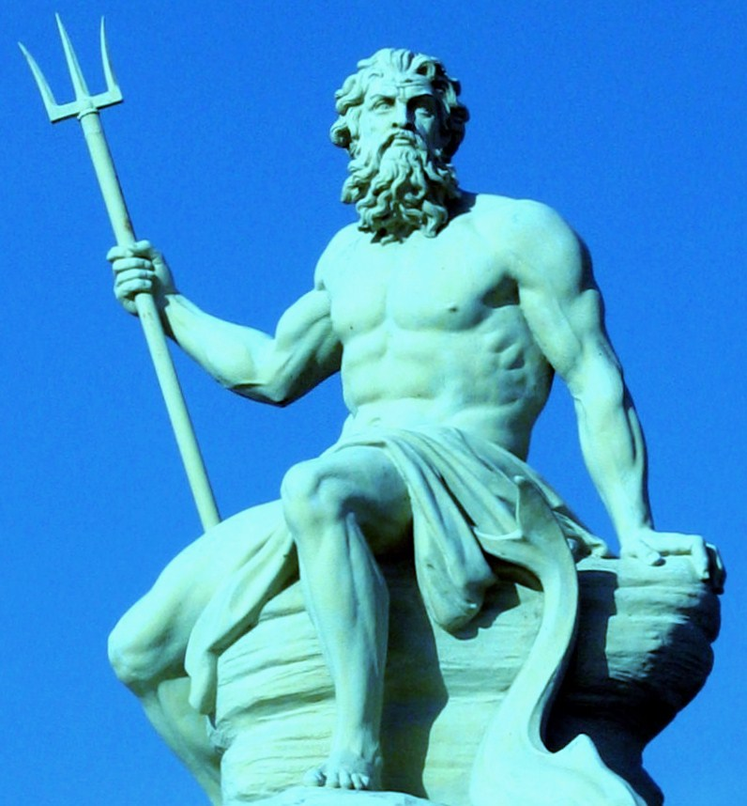
Poseidon is the god of the sea and brother to Zeus. Poseidon is Odyssseus’ divine antagonist and constantly complicates his journey home.

Slide 10
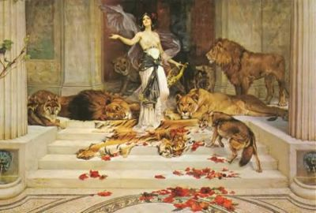
Circe is the beautiful witch-goddess who transforms Odysseus’s crew into swine when he lands on her island.

Slide 11
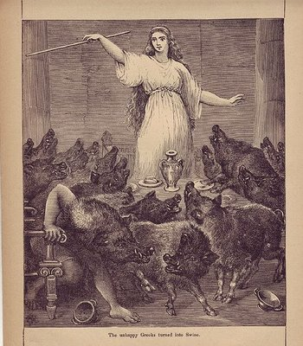
Circe is the beautiful witch-goddess who transforms Odysseus’s crew into swine when he lands on her island.

Slide 12
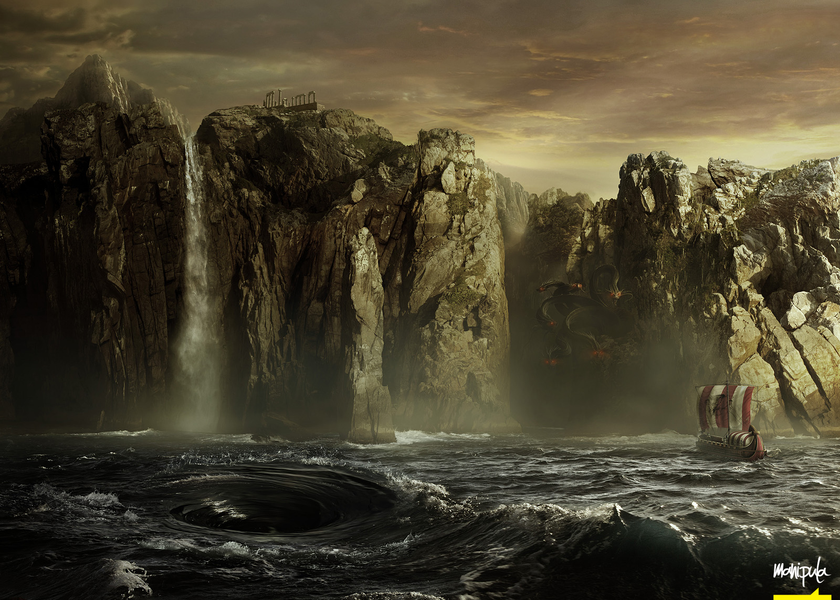
Scylla was a monstrous sea goddess who haunted the rocks of certain narrow strait opposite the whirlpool daemon Kharybdis. Ships who sailed too close to her rocks would lose six men to her ravenous, darting heads.
Charybdis was a sea monster or goddess whose gigantic whirlpool swirled in the straits, opposite the cliffs of the monster Scylla. She was the goddess of the tides.

Slide 13
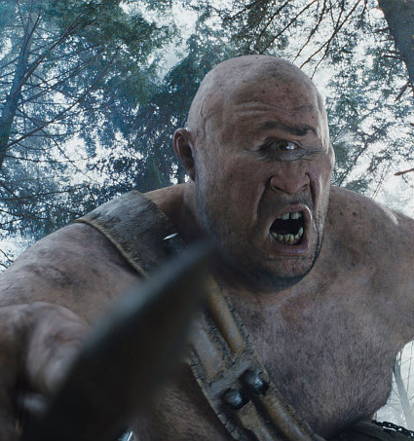
Polyphemus is one of the Cyclopes (uncivilized one-eyed giants) whose island Odysseus comes to soon after leaving Troy.

